Slide 1
Limbic Arc
Platform Assessment
Companion to the detailed Technical Assessment (v0.4)

Slide 2
The bottom line
Two good platforms — neither is the problem.
Exigo runs your distributor network, ranks and commissions. Fluid is your modern online store. Keep both.
The problem is the gap between them.
The seam between the two systems, the aging software your websites are built on, and having no tech team to change any of it.
Recommendation: modernize gradually and safely.
One piece at a time. The first step is small, low-risk, and starts paying off in weeks — but it needs a team in place.
Limbic Arc — Platform Assessment
2

Slide 3
What we looked at
We assessed the surfaces your people actually touch — plus the plumbing between your two platforms:
• Your customer-facing site, customer account area, and distributor (affiliate) back office
• The connection between Exigo and Fluid
• The concerns leadership cares about: billing reliability, security, customer experience, speed of change, and insights
Out of scope: your core Web App — except that customers shouldn't have to log in repeatedly to reach it.
Limbic Arc — Platform Assessment
3

Slide 4
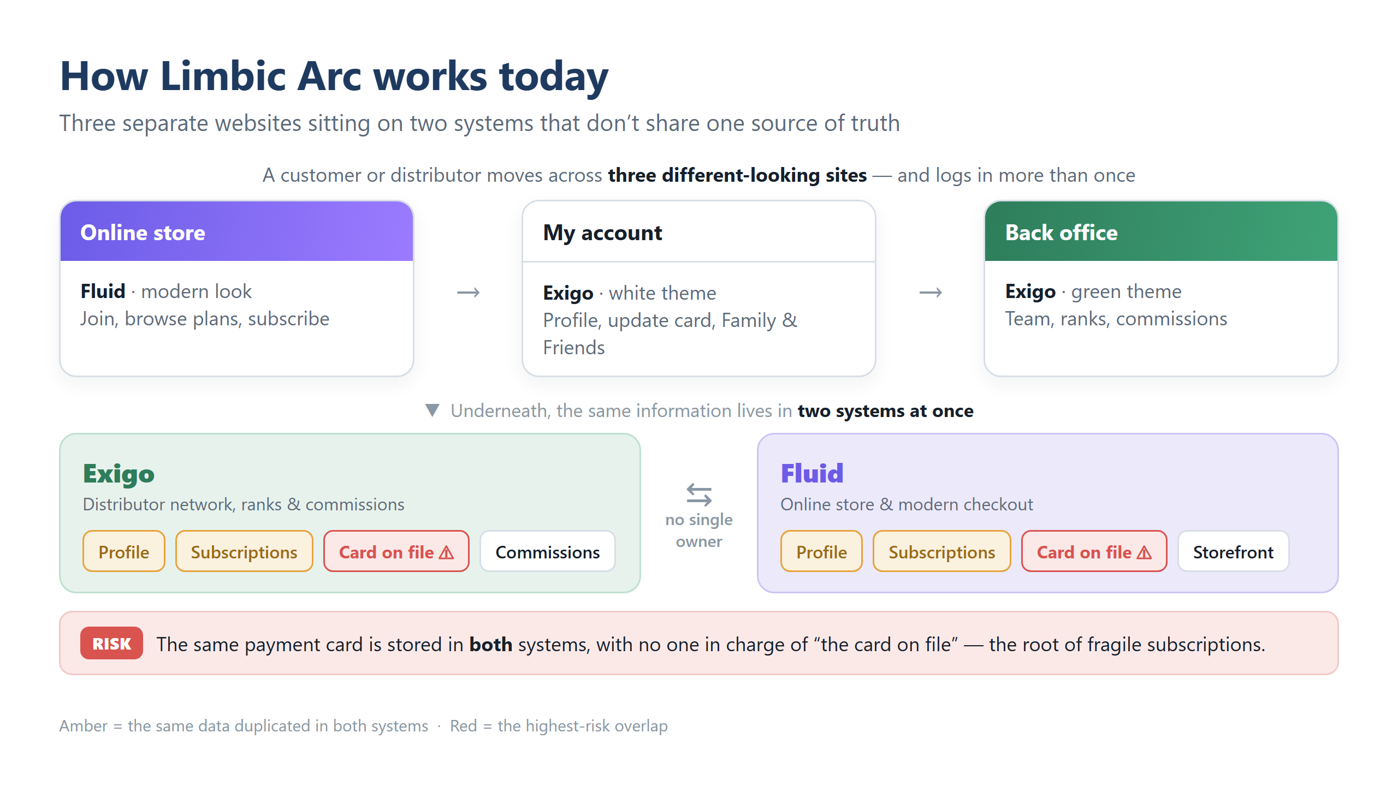
Limbic Arc — Platform Assessment
4

Slide 5
The five things that matter
# | What's happening | Why it matters to the business
1 | Payment & subscription data is split between Exigo and Fluid; no single “card on file.” | Direct risk to revenue & trust — fragile subscriptions, billing inconsistencies, extra compliance cost. #1 to fix.
2 | You depend on your vendor to change anything (old, tightly-wound website software). | You don't control your own speed or cost. Your roadmap may not run on your own calendar.
3 | Three different website experiences and repeated logins. | Brand & trust erosion, lower conversion, more support tickets.
4 | No proper access control, no single sign-on or observability | Security & oversight gaps. Issue triage becomes difficult
5 | No technology team. | The root cause of #2.
Limbic Arc — Platform Assessment
5

Slide 6
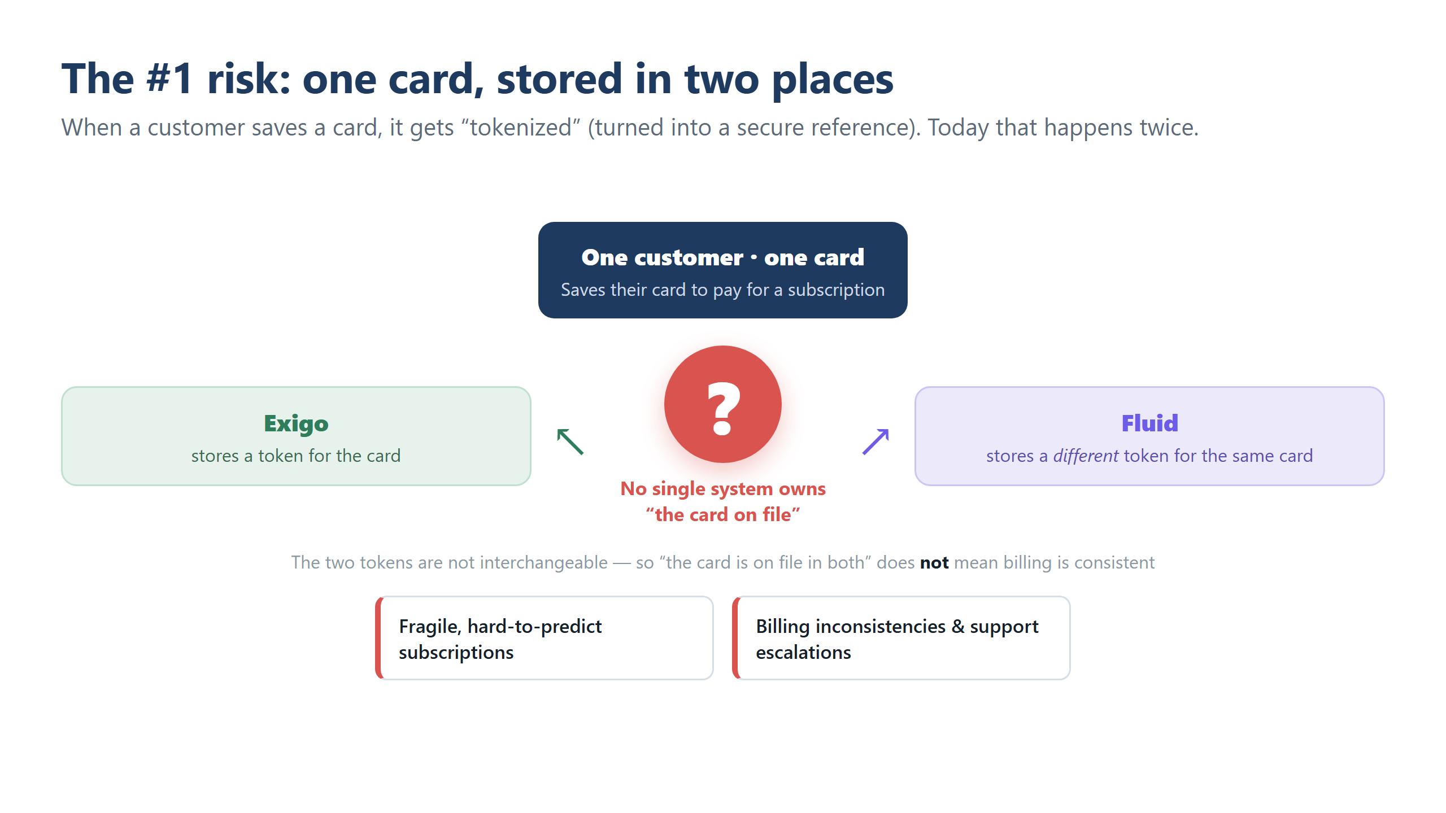
Limbic Arc — Platform Assessment
6

Slide 7
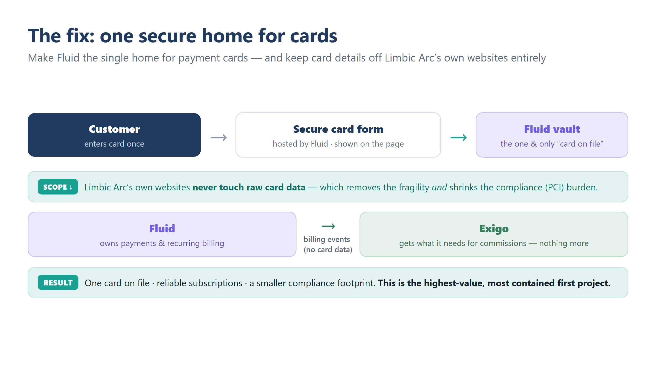
Limbic Arc — Platform Assessment
7

Slide 8
You don't control your own speed
Your customer and distributor websites are built on an aging “starter-kit” that came with Exigo — meant to bootstrap onto Exigo's own flows, not to be a long-term product platform.
• Old software only the vendor fully understands — presentation, business rules and data access are all tangled together, with thin documentation.
• Even small changes can be slow and get expensive — changes may need vendor know-how and might wait in the vendor's queue.
• You don't set your own timeline or cost — your roadmap may have a hard dependency on the vendor's priorities.
This is why you feel stuck “firefighting.”
Limbic Arc — Platform Assessment
8

Slide 9
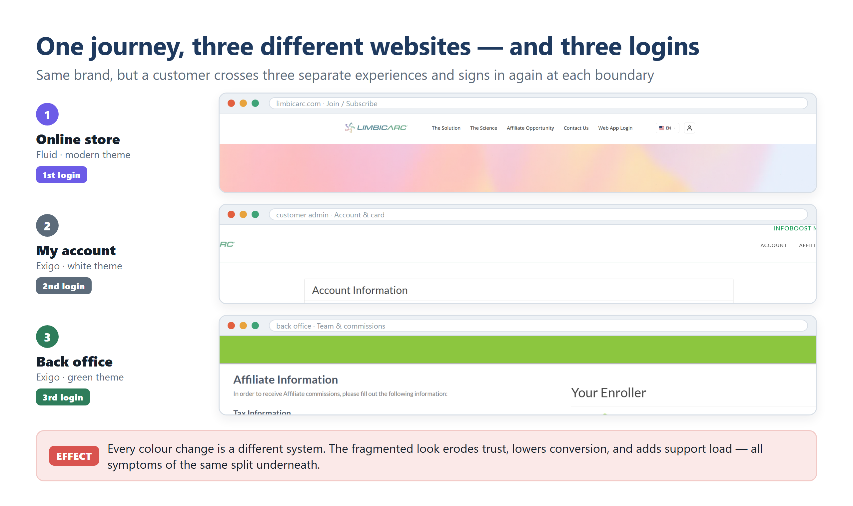
Limbic Arc — Platform Assessment
9

Slide 10
No technology team
You work through capable vendors, but have no technical counterpart of your own.
• No one to own the code or direct the vendors — so change waits in their queue and you stay in reactive mode.
• This is the upstream cause of most of the other issues. With no one on your side, change is outsourced by default.
• Architecture alone won't fix it — better systems help, but can't substitute for having someone on your side to drive them.
This is why the staffing decision — coming up — gates everything.
Limbic Arc — Platform Assessment
11

Slide 11
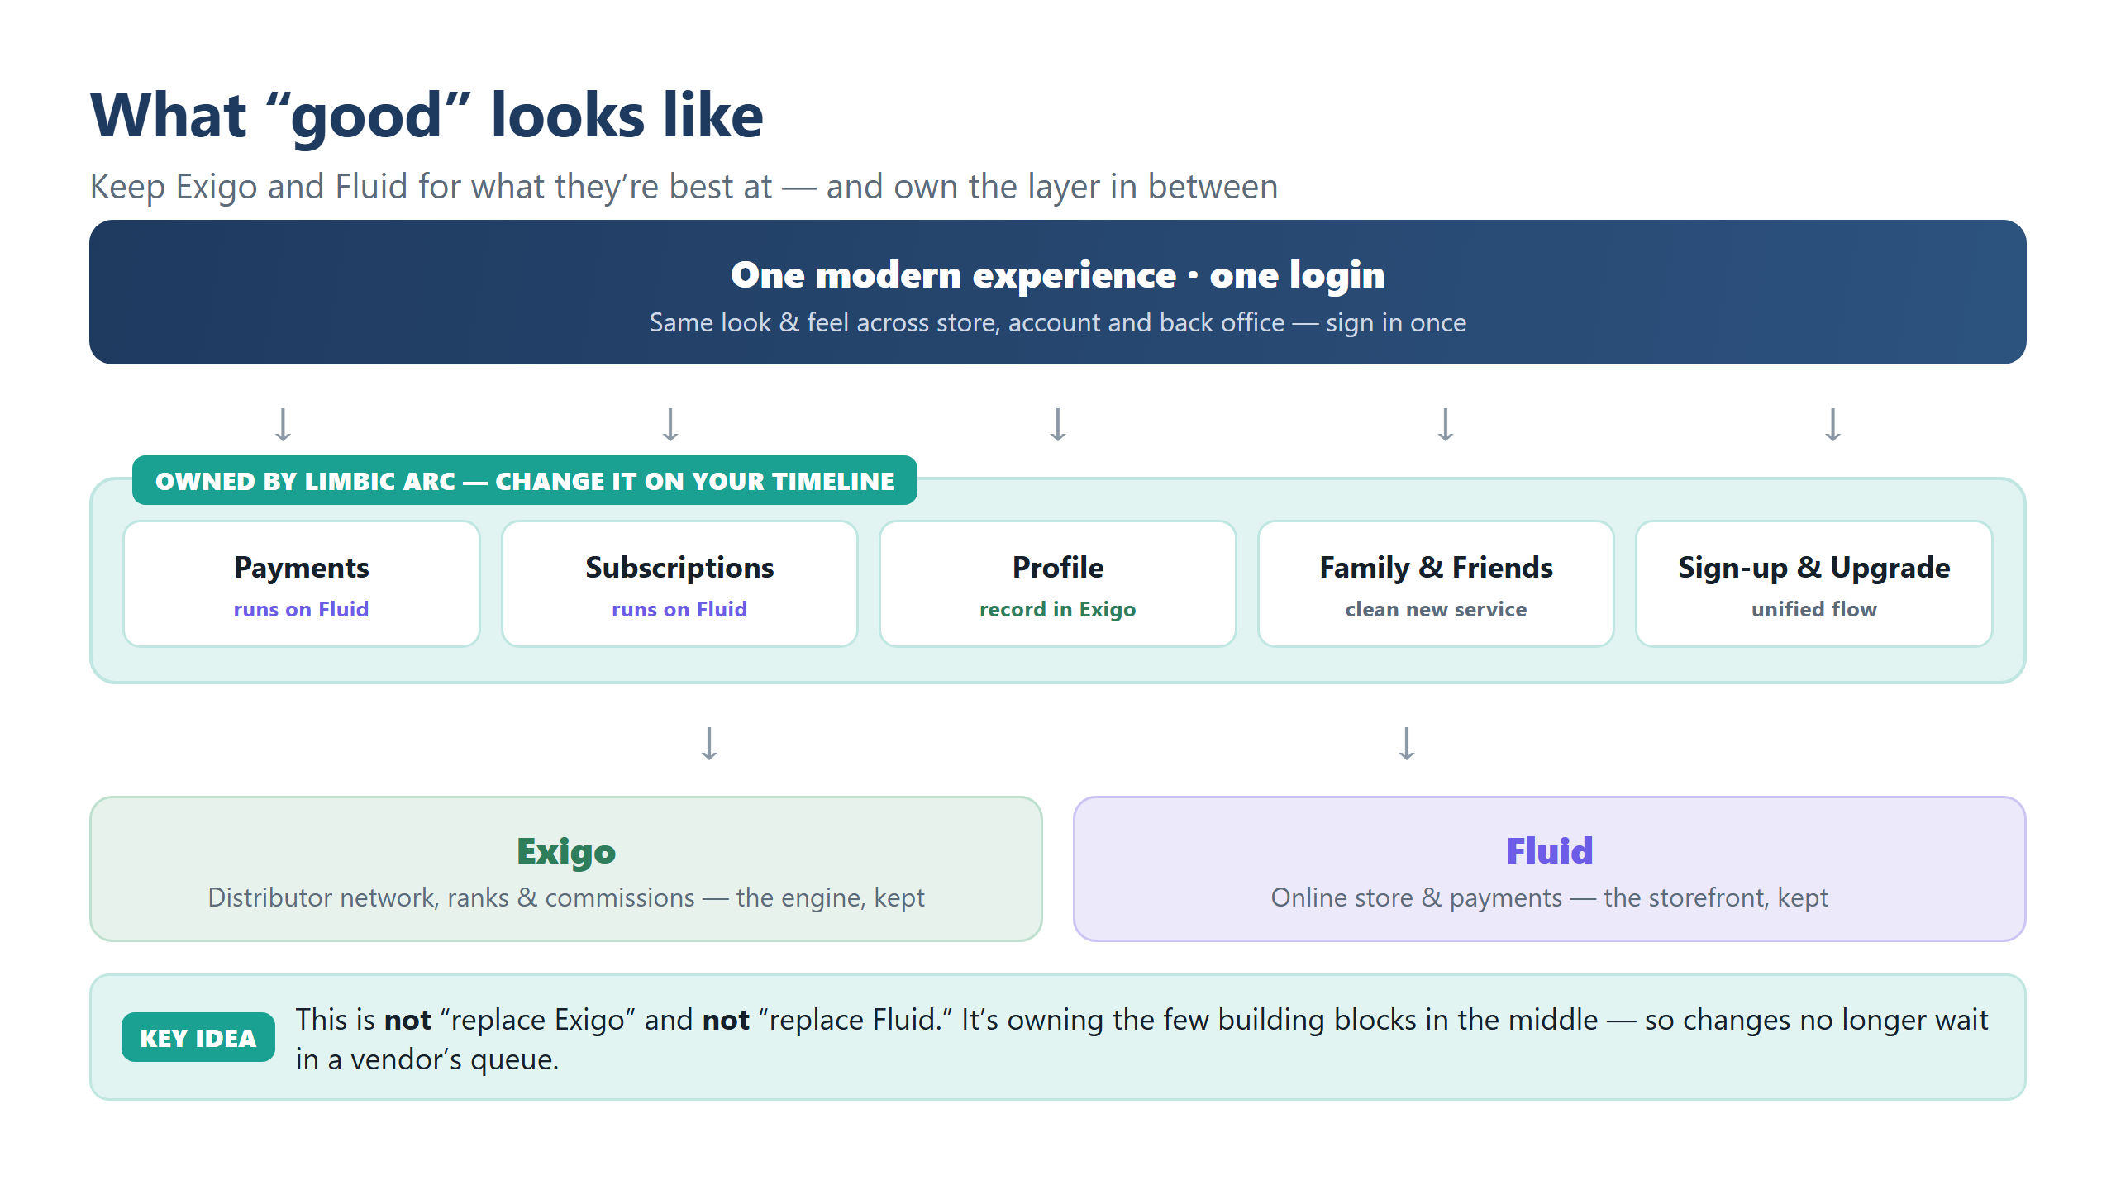
Limbic Arc — Platform Assessment
12

Slide 12
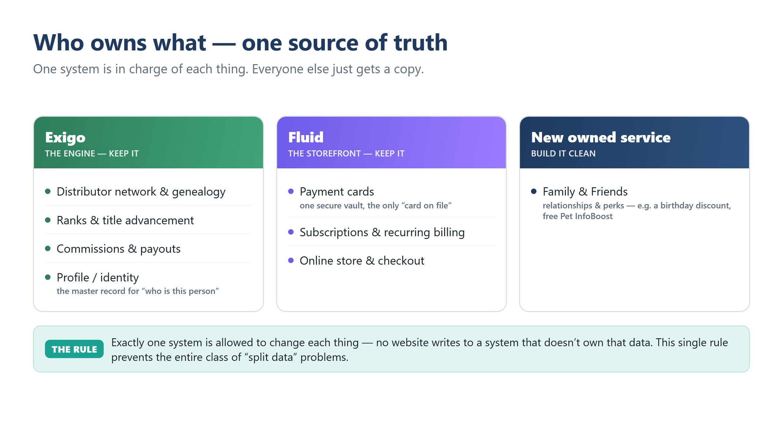
Limbic Arc — Platform Assessment
13

Slide 13
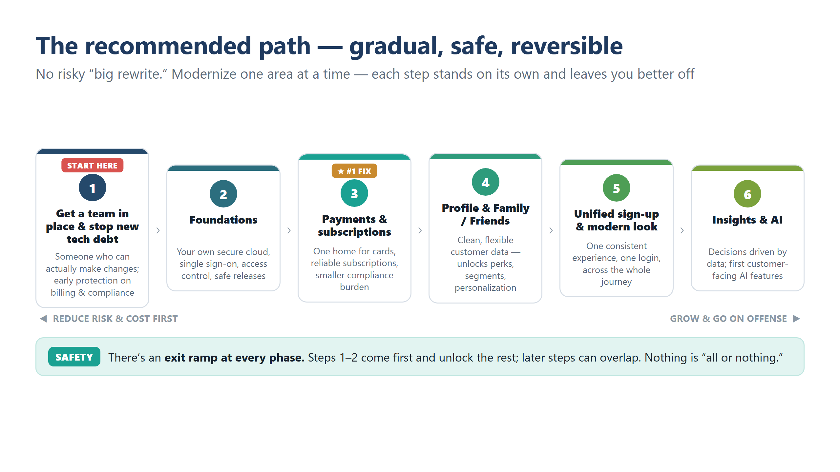
Limbic Arc — Platform Assessment
14

Slide 14
Immediate next steps
1
Decide how to staff it
Choose from three options: hire your own team (Longer ramp up time), bring in a partner (fastest start), or start with a partner and grow your own team over time (hybrid). The rest of the plan waits on this decision.
2
Kick off a small, fixed-scope first step (2 weeks)
Deliverables: (a) Document the current Exigo–Fluid integration and data flows - a map the team can actually work from. (b) Audit on all subscription and payment writes. (c) Stop any new card tokenization happening on the Exigo side while the full fix is scoped. (d) Plug the hole by linking to fluid for any new subscriptions happening in the backoffice. (e) Produce a properly sized plan and timeline for the phases that follow.
3
Confirm a few specifics with your teams & vendors (3-4 weeks)
Deliverables: (a) Build the foundation - cloud setup, automated deployments, guard rails. (b) Extract customer profiles and subscriptions into services you own. (c) Replace the current Family & Friends workaround with a purpose-built service that makes perks straightforward to manage. (d) Surface everything through the existing back office so distributors see one consistent experience without disruption.
Limbic Arc — Platform Assessment
16

Slide 15
The right two platforms. A real business.
What's missing is ownership of the layer in between — and the capability to change it.
The path is low-risk and incremental, the first step is small, and the payoff is substantial: lower risk, faster delivery, a better experience, and the freedom to innovate.

Slide 16
Questions?
Limbic Arc — Platform Assessment
16

